Slide 1
Lecture 1
Introduction
Basic Security Concepts

Slide 2
What is Cyber Security?
Highly Technical
People, processes, and technology
Legislation and Regulation
Risk management

Slide 3
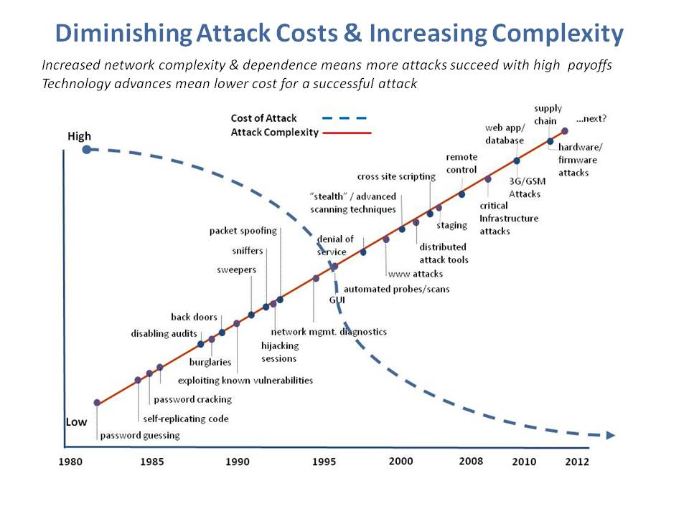
Lecture 1
Copyright of Information Security Incorporated © 2008–2014

Slide 4
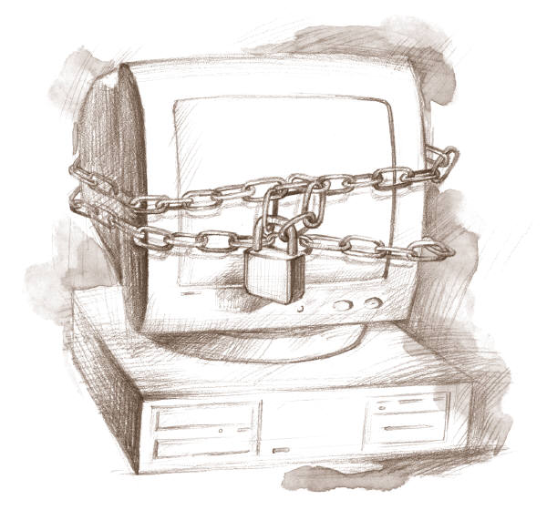
What Can I Do?

Slide 5
Course Objective
Understanding of Cyber Security Principle
Industry + Academics
Managerial + Technical
Leadership and Communication
DEFENSE!
Lecture 1

Slide 6
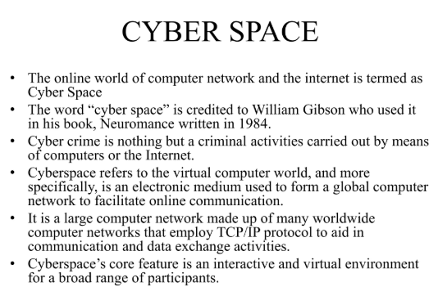
Lecture 1

Slide 7
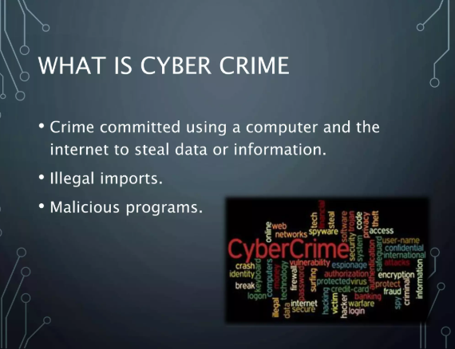
Lecture 1

Slide 8
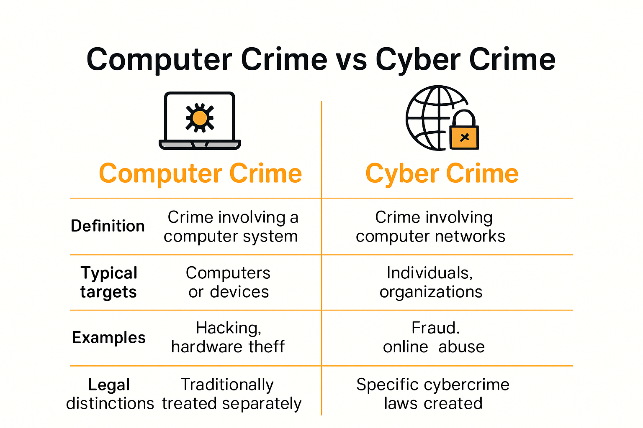
Lecture 1

Slide 9
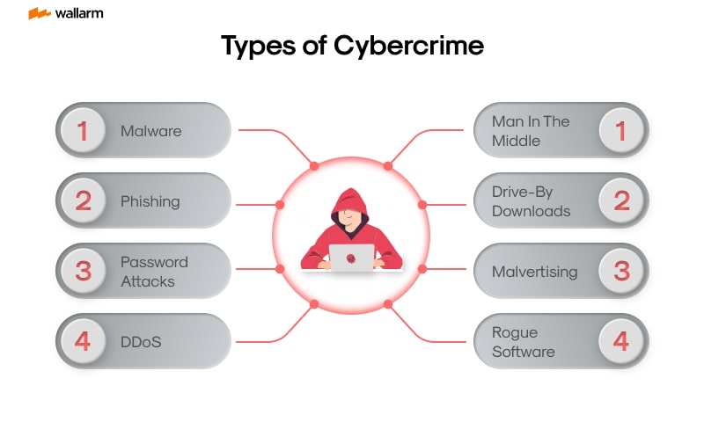
Lecture 1

Slide 10
Security Objectives
Confidentiality: prevent/detect/deter improper disclosure of information
Integrity: prevent/detect/deter improper modification of information
Availability: prevent/detect/deter improper denial of access to services
Lecture 1

Slide 11
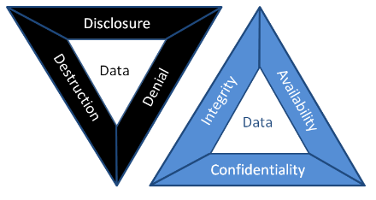
CIA Triad

Slide 12
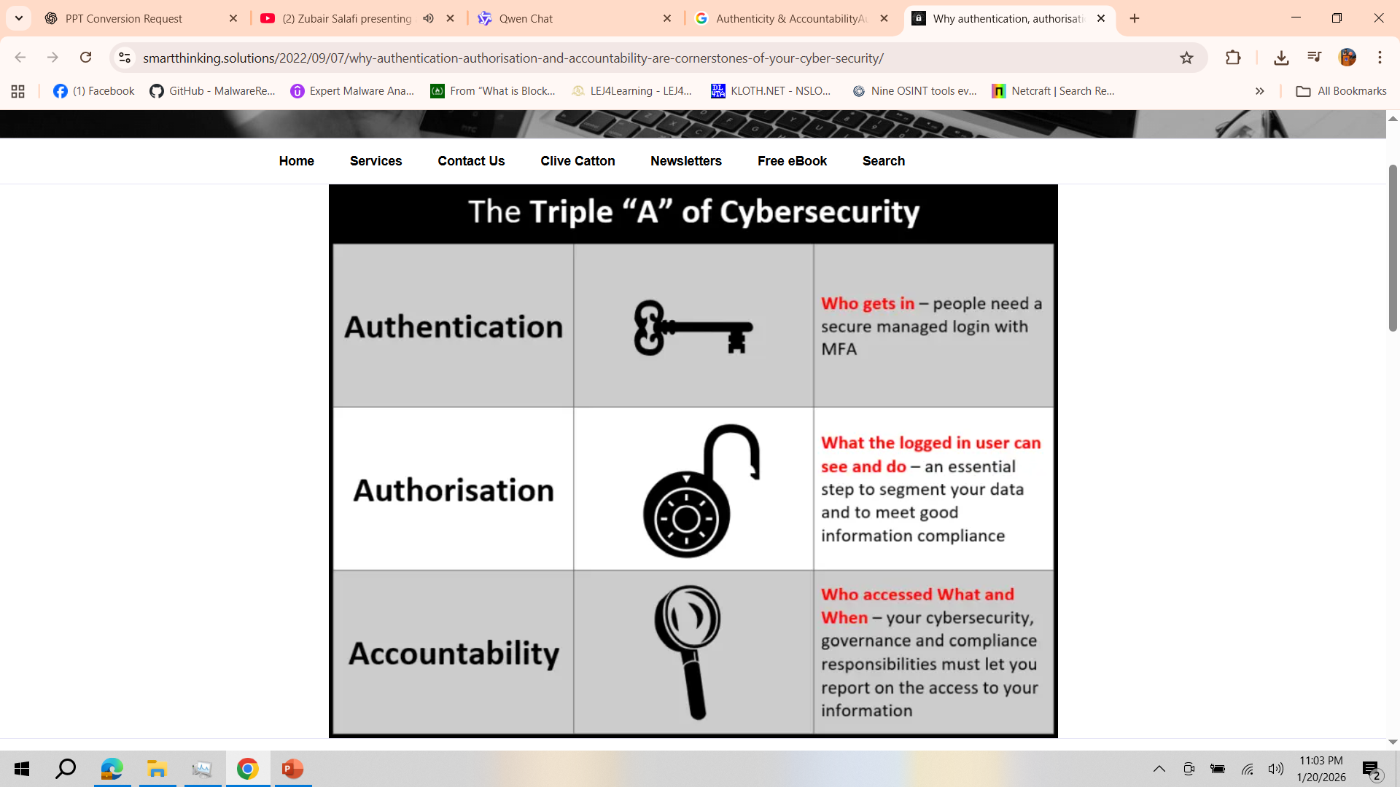
Authenticity & Accountability

Slide 13
Main Objective
Securing computing resources: prevent/detect/deter improper use of computing resources
  Hardware
  Software
  Data
  Network
Lecture 1

Slide 14
Question 1: What is the trade off between the security objectives?
Confidentiality reduces integrity because secret data is higher quality
Integrity requires that the data is kept in an isolated location and cannot be accessed
Increased confidentiality may reduce availability
Confidential and correct data has high trade off availability
Lecture 1

Slide 15
Achieving Security
Organizational Goals
  Why to invest in security protection?
Policy
  What to protect?
Mechanism
  How to protect?
Assurance
  How good is the protection?
Lecture 1

Slide 16
Security Policy
Organizational
Policy
Computerized
Information System
Policy
Lecture 1

Slide 17
Question 2: Why do we need to fit the security policy into the organizational policy?
Because the management would not pay for it otherwise
Because security policy should support and protect organizational goals
Because this will make the implementation easier
Because it is mandated by law and regulation
Lecture 1

Slide 18
Security Mechanism
Prevention
Detection
Tolerance/Recovery
Lecture 1

Slide 19

Security by Obscurity
Hide inner working of the system
Bad idea!
  Vendor independent open standard
  Widespread computer knowledge
Lecture 1

Slide 20
Security by Legislation
Instruct users how to behave
Not good enough!
  Important
  Only enhance security
  Targets only some of the security problems
Lecture 1

Slide 21
Security Tradeoffs
Security
Functionality
COST
Ease of Use
Lecture 1

Slide 22
Threat, Vulnerability, Risk
Threat: potential occurrence that can have an undesired effect on the system
Vulnerability: characteristics of the system that makes is possible for a threat to potentially occur
Attack: action of malicious intruder that exploits vulnerabilities of the system to cause a threat to occur
Risk: measure of the possibility of security breaches and severity of the damage
Lecture 1

Slide 23
Types of Threats (1)
Errors of users
Natural/man-made/machine disasters
Dishonest insider
Disgruntled insider
Outsiders
Lecture 1

Slide 24
Types of Threats (2)
Disclosure threat – dissemination of unauthorized information
Integrity threat – incorrect modification of information
Denial of service threat – access to a system resource is blocked
Lecture 1

Slide 25
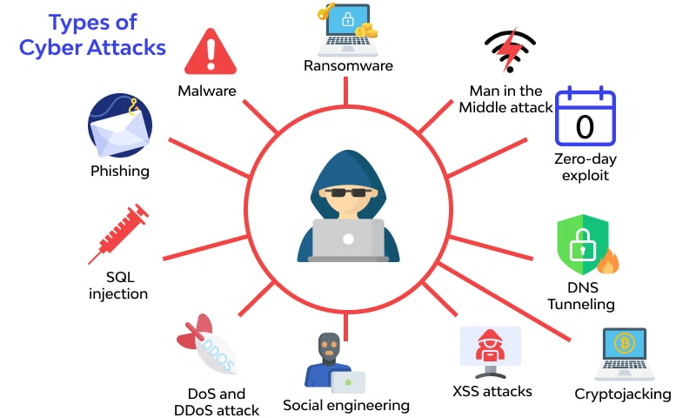
Lecture 1

Slide 26
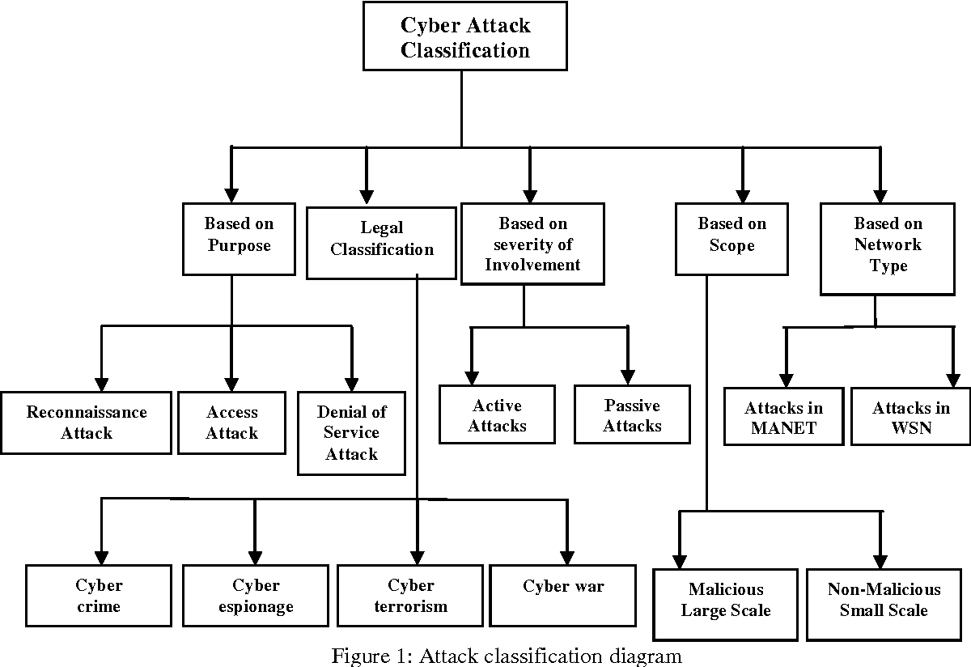
Lecture 1

Slide 27
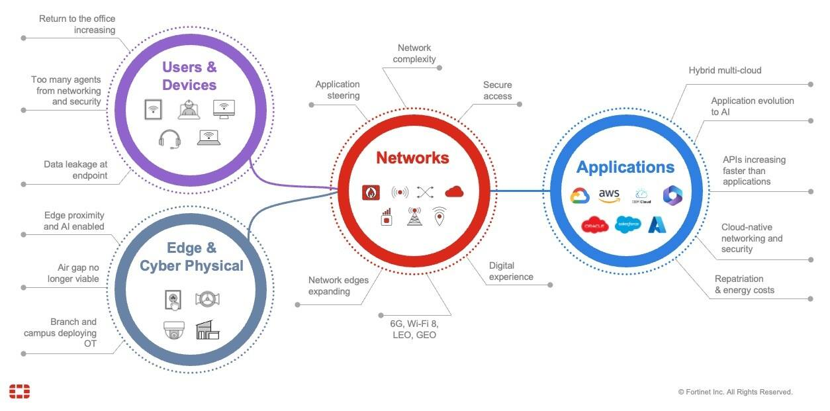
Lecture 1

Slide 28
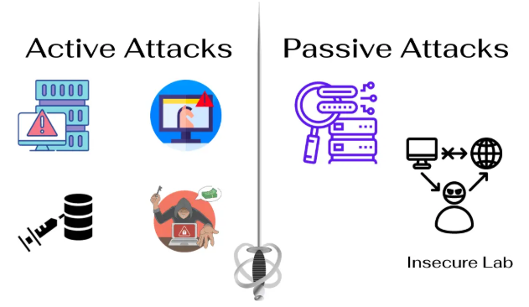
Lecture 1

Slide 29
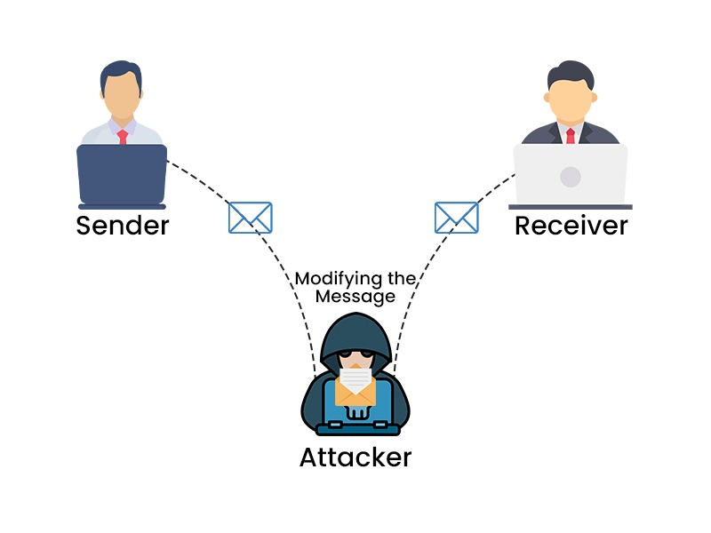
Type of Attack?
Lecture 1

Slide 30
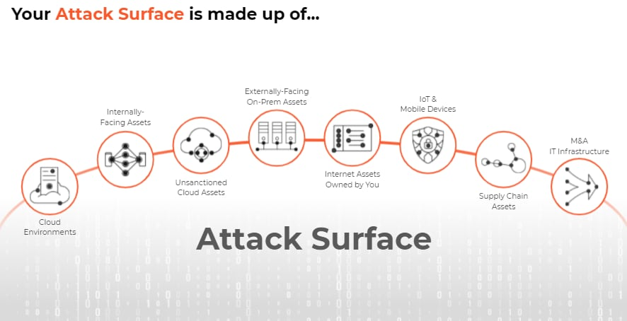
Lecture 1

Slide 31
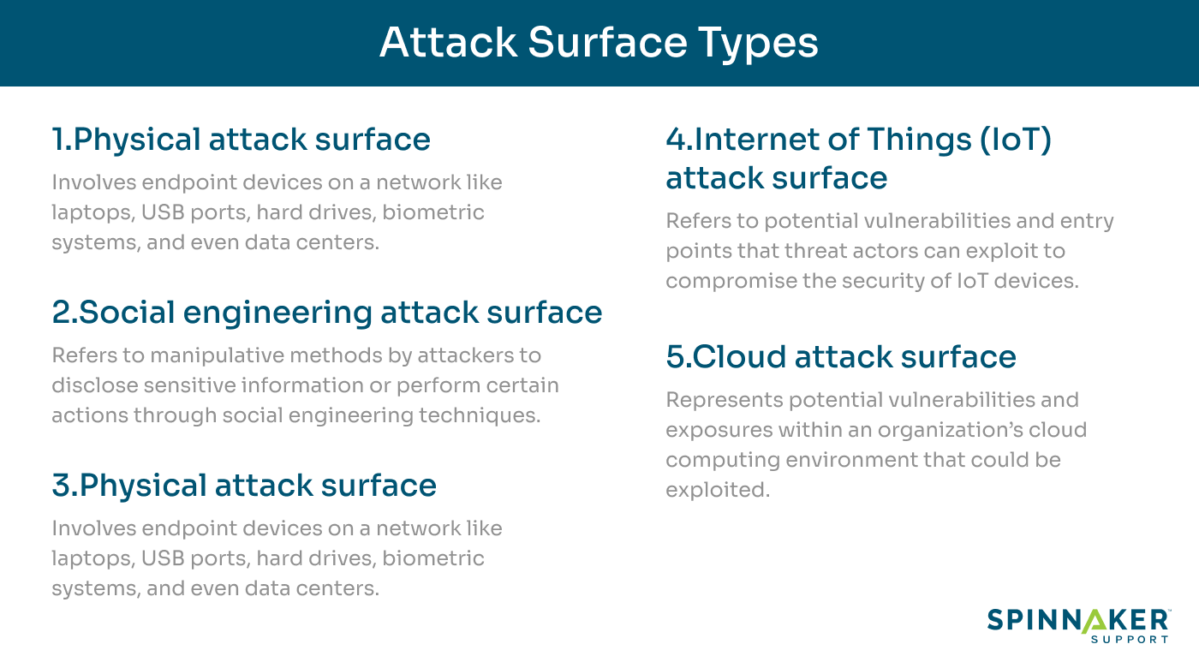
Lecture 1

Slide 32
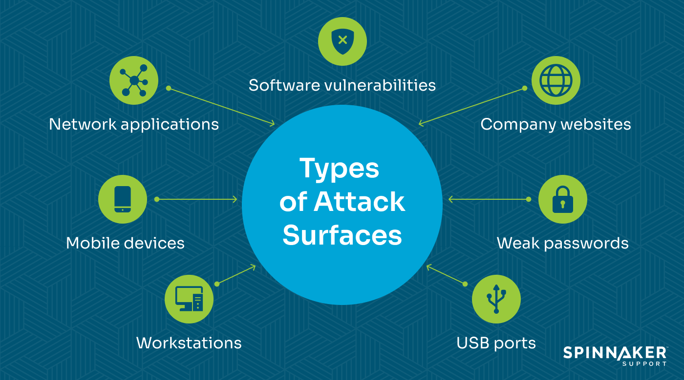
Lecture 1

Slide 33
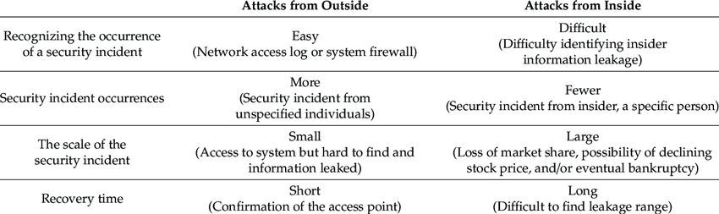
Lecture 1

Slide 34
Types of Attacks (1)
Interruption – an asset is destroyed, unavailable or unusable (availability)
Interception – unauthorized party gains access to an asset (confidentiality)
Modification – unauthorized party tampers with asset (integrity)
Fabrication – unauthorized party inserts counterfeit object into the system (authenticity)
Denial – person denies taking an action (authenticity)
Lecture 1

Slide 35
Types of Attacks (2)
Passive attacks:
  Eavesdropping
  Monitoring
Active attacks:
  Masquerade – one entity pretends to be a different entity
  Replay – passive capture of information and its retransmission
  Modification of messages – legitimate message is altered
  Denial of service – prevents normal use of resources
Lecture 1

Slide 36
Malicious Attacks
Method: skills, knowledge, tools, information, etc.
Opportunity: time and access
Motive: reason to perform the action
How can defense influence these aspects of attacks?
Lecture 1

Slide 37
Computer Criminals
Amateurs: regular users, who exploit the vulnerabilities of the computer system
  Motivation: easy access to vulnerable resources
Crackers: attempt to access computing facilities for which they do not have the authorization
  Motivation: enjoy challenge, curiosity
Career criminals: professionals who understand the computer system and its vulnerabilities
  Motivation: personal gain (e.g., financial)
Lecture 1

Slide 38
Methods of Defense
Prevent: block attack
Deter: make the attack harder
Deflect: make other targets more attractive
Detect: identify misuse
Tolerate: function under attack
Recover: restore to correct state
Lecture 1

Slide 39
Information Security Planning
Organization Analysis
Risk management
Mitigation approaches and their costs
Security policy
Implementation and testing
Security training and awareness
Lecture 1

Slide 40
Risk Management
Lecture 1

Slide 41
Risk Assessment
Threats
RISK
Vulnerabilities
Consequences
Lecture 1

Slide 42



Risk Assessment
Business Policy Decision
    Communication between technical and administrative employees
    Internal vs. external resources
    Legal and regulatory requirements
Developing security capabilities
Optimal level of security
at a minimum cost
Cost
Security Investment
Cost of Breaches
0 %
Security level
100%

Slide 43
Real Cost of Cyber Attack
Damage of the target may not reflect the real amount of damage
Services may rely on the attacked service, causing a cascading and escalating damage
Need: support for decision makers to
  Evaluate risk and consequences of cyber attacks
  Support methods to prevent, deter, and mitigate consequences of attacks
Lecture 1

Slide 44
Risk Management Framework
(Business Context)
Understand Business
Context
Identify Business
and Technical Risks
Carry Out Fixes
and Validate
Synthesize and Rank
Risks
Define Risk
Mitigation Strategy
Measurement and Reporting
Lecture 1

